Slide 1
PRESERVING DIGITAL ASSETS
Name: Parvathi Saxena
Course: M.Tech Advanced Computing

Slide 2
CONTENTS
Abstract
Digital Preservation
Threats to Digital Preservation
Digital Preservation Techniques
Literature Review
Conclusion
References

Slide 3
ABSTRACT
Digital Information drives our economy, spurs our culture and connects our economy. It has changed how we communicate and learn. For centuries, we have saved books, photos, maps and other sources of knowledge. With the growing importance of digital data, the wider community pays almost no attention to the problems of preserving this digital information for the future. Our digital assets are just as valuable. Traditional information sources can easily survive for years, decades and centuries. But digital items are fragile and require special care to preserve them and make them usable. The preservation of digital data for the long term presents a variety of challenges from technical to social and organizational. The technical challenge is to ensure that the information, generated today, can survive long term changes in storage media, devices and in other data formats. There presently exists no inexpensive way to preserve one's digital data for posterity.

Slide 4
DIGITAL PRESERVATION
“Long-term, error-free storage of digital information, with means for retrieval and interpretation, for the entire time span the information is required for._{[5]}”
Digital Content
Born Digital
Retrospectively Converted

Slide 5
THREATS TO DIGITAL PRESERVATION
Threats
Natural Disaster
Technical Risks
Security Threats
Programmatic Concerns

Slide 6
DIGITAL PRESERVATION TECHNIQUES
Techniques
Encapsulation
Emulation
Technology Preservation
Migration
Bit- Stream Copying
a.k.a Computer Museum
Disaster Recovery Strategy
a.k.a Replication
Backing up data
Generating Metadata
To renew data overtime
Transfer from one generation technology to subsequent technology
Emulating an obsolete environment to an existing one

Slide 7
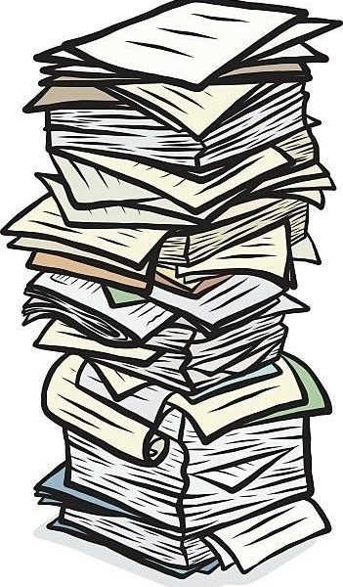
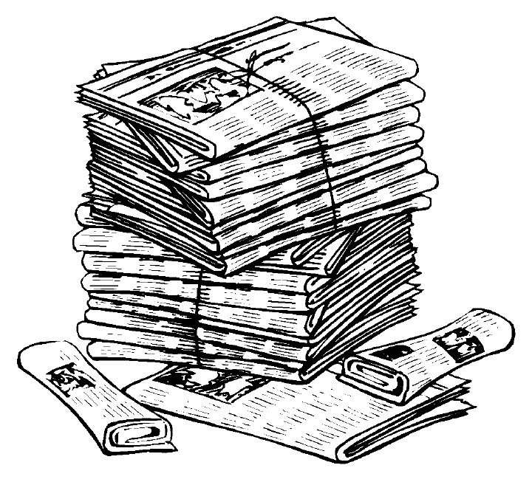
LITERATURE REVIEW

Slide 8
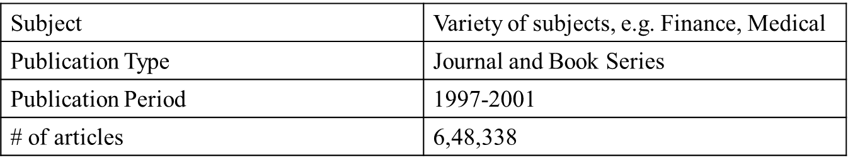
Paper Title: | No More 404s: Predicting Referenced Link Rot in Scholarly Articles for Pro-Active Archiving
Published In: | JCDL '15 Proceedings of the 15th ACM/IEEE-CS | Year: | 2015
Problem Identified: | To detect link rot on web based published articles.
Proposed Solution: | Created a link rot predictor based on SVM.
Data Source: | Elsevier XML format of publications from the year 1997 to 2012.
Findings: | Observation was that compared with current archives (62.3%), the simulated pro-active archive preserved a significantly larger number of rotten links (84.8%).
Conclusion: | Simulated archival solution outperforms current web archives.
Future Scope: | Testing this in a real-world archival setting where the classifier evaluation could be further improved.

Slide 9
Paper Title: | Using Transactional Web Archives To Handle Server Errors
Published In: | JCDL '15 Proceedings of the 15th ACM/IEEE-CS | Year: | 2015
Problem Identified: | Web archives don’t cover the entire web.
Proposed Solution: | When a page gets down retrieve the copy from the achieve and make it available to the user, thus masking the error from the user.
Technologies Used: | SiteStory Web Archieve, Java Application and Tomcat Server, Berkeley DB.
Working: | mod_uws gets active when an error occurs. mod_uws will send request to the SiteStory archive to retrieve the most recently archived copy of the requested URL.
Conclusion: | The overall performance is slow.
Future Scope: | Adding a load balance to the tomcat server.
SiteStory
mod_sitestory
mod_uws

Slide 10
Paper Title: | A Portable Strategy for Preserving Web Applications Functionality
Published In: | JCDL '17 Proceedings of the 17th ACM/IEEE-CS | Year: | 2017
Problem Identified: | Preserving entire web applications isn’t feasible.
Proposed Solution: | Emulate those modules that do the achieving procedure.
Data Source: | Speech Presentation in Homeric Epic Project ( it is a MySQL database), Data from Liberal Arts Instructional Technologies Services (LAITS).
Working: | Extraction Identify dependencies and decoupling application Data validation with redeployment Distribution
Conclusion: | Emulation ensures that the application runs correctly in the future.
Future Scope: | Automate these processes.

Slide 11
Paper Title: | Preserving Digital Information Forever
Published In: | Digital Libraries, San Antonio, TX, ACM | Year: | 2000
Problem Identified: | To create a standard for preserved data i.e. for cataloguing the content.
Proposed Solution: | The Victorian Electronic Record Strategy
Conclusion: | Two preservation techniques migration and encapsulation, have been identified that have a high probability of allowing future generations access to information.

Slide 12
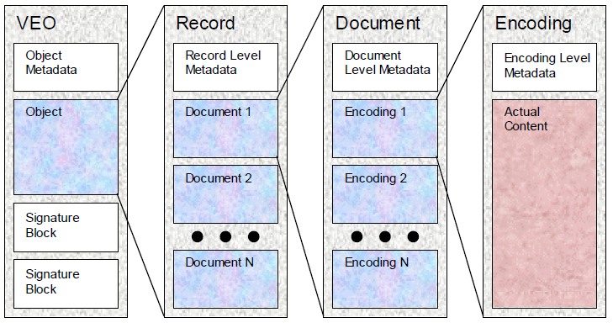
Fig: VERS Object_{[4]}

Slide 13
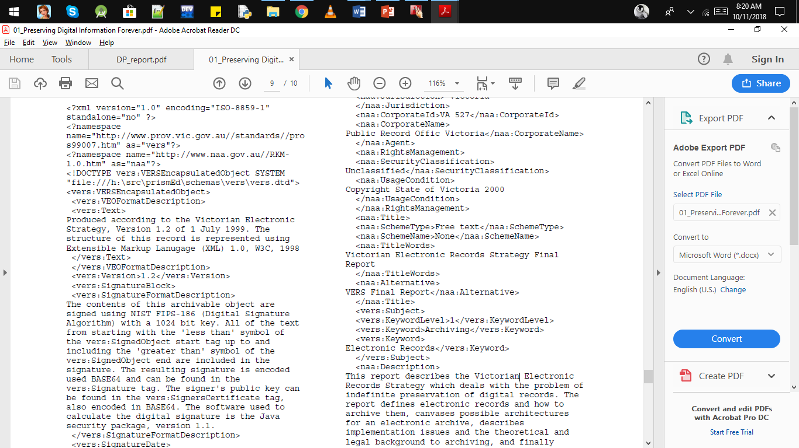
_{[4]}

Slide 14
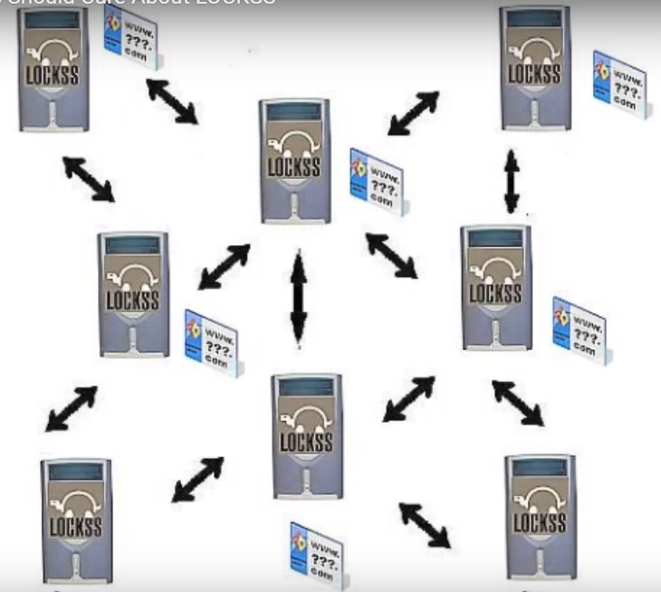

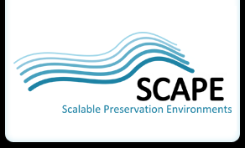
OTHER DIGITAL PRESERVATION MODELS
LOCKSS (Lots Of Copies Keep Stuff Save)
SCAPE(Scalable Preservation Environments)
https://www.lockss.org/about/how-it-works/works_it.jpeg

Slide 15
CONCLUSION
“There is no permanent solution to preserving data indefinitely but maybe to some extent.”
Digital Content
Better over traditional content
Preservation solutions are not a permanent kind
Digital Preservation
Challenging Task
The best techniques are costlier
Mostly done by librarians

Slide 16
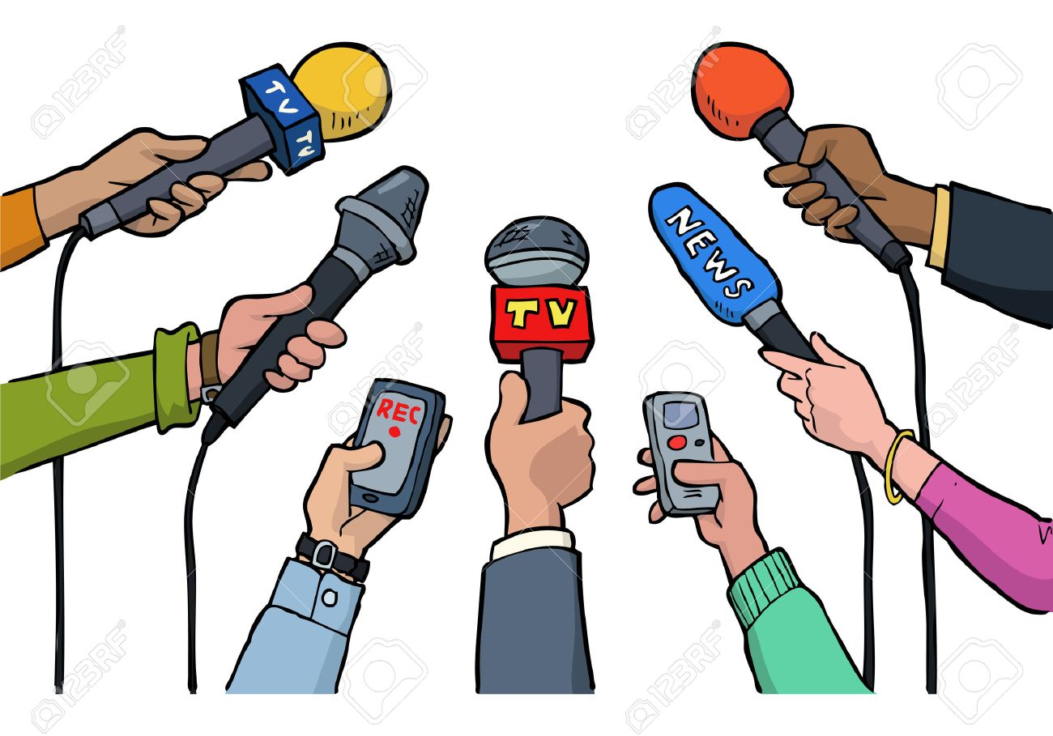
What can you do?
Identity what you want to save
Decide what is most important to you
Organize the content
Save Copies

Slide 17
REFERENCES
[1] | Zhou, Claire Grover, Martin Klein and Richard Tobin, “No More 404s: Predicting Referenced Link Rot in Scholarly Articles for Pro-Active Archiving”, 2015, JCDL 2015 Proceedings of the 15th ACM/IEEE-CS.
[2] | ZhiwuXie, Prashant Chandrasekar, and Edward A. Fox, “Using Transactional Web ArchivesTo Handle Server Errors ", 2015, JCDL 2015 Proceedings of the 15th ACM/IEEE-CS.
[3] | Weijia Xu ; Maria Esteva ; Deborah Beck ; Yi-Hsuan Hsieh, “A Portable Strategy for Preserving Web Applications Functionality”, 2017, JCDL '17 Proceedings of the 17th ACM/IEEE-CS.
[4] | Andrew Waugh, Ross Wilkinson, Brendan Hills, and Jon Dell’oro, “Preserving Digital Information Forever”, 2000, Digital Libraries, San Antonio, TX, ACM.
[5] | Elizabeth Yakel, “Digital Curation”, 2002, OCLC Systems & Services: International digital library perspectives.

Slide 18


